Slide 1


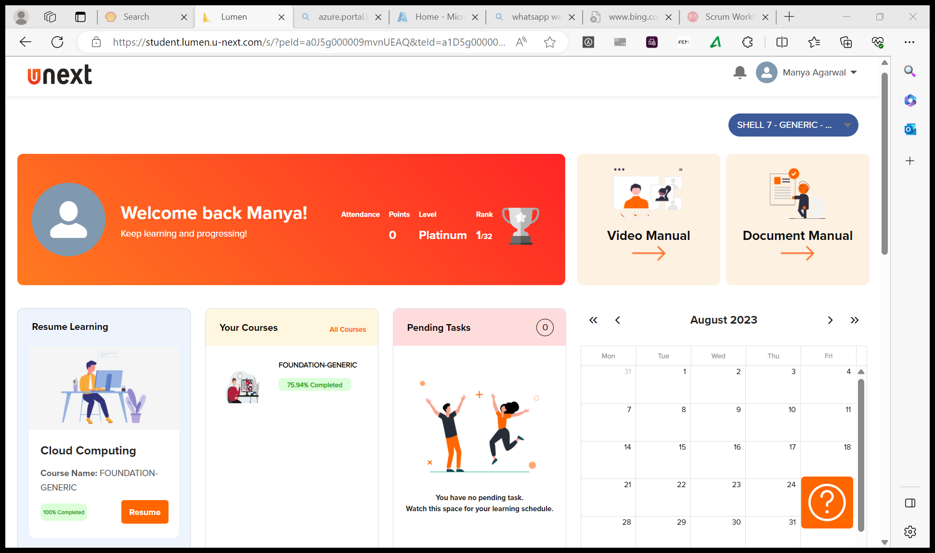
Journey Presentation
Submitted By:
Manya Agarwal
Employee No. : 654801

Slide 2
Journey Presentation Week-5

Slide 3
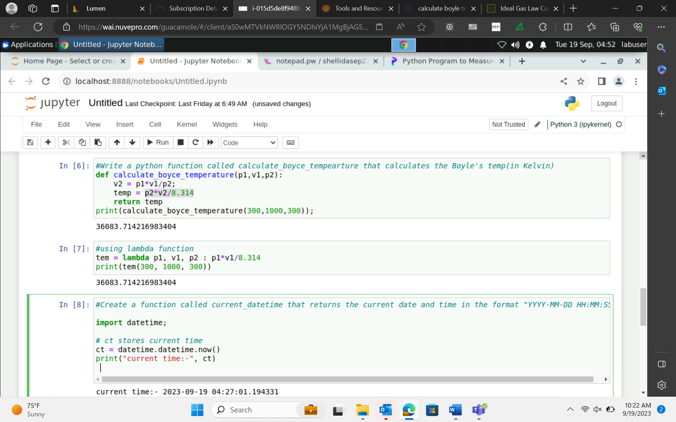
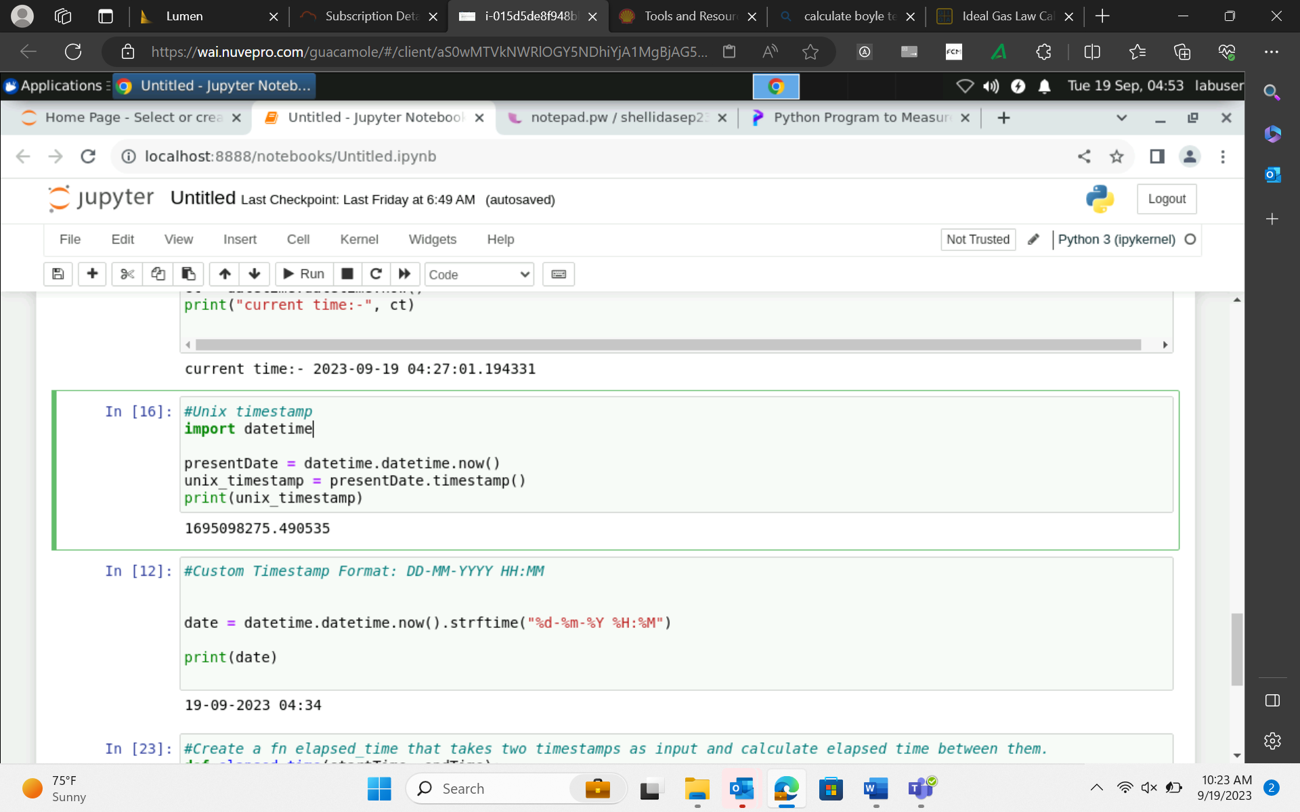
19-Sep-23 (Tuesday) – Python

Slide 4
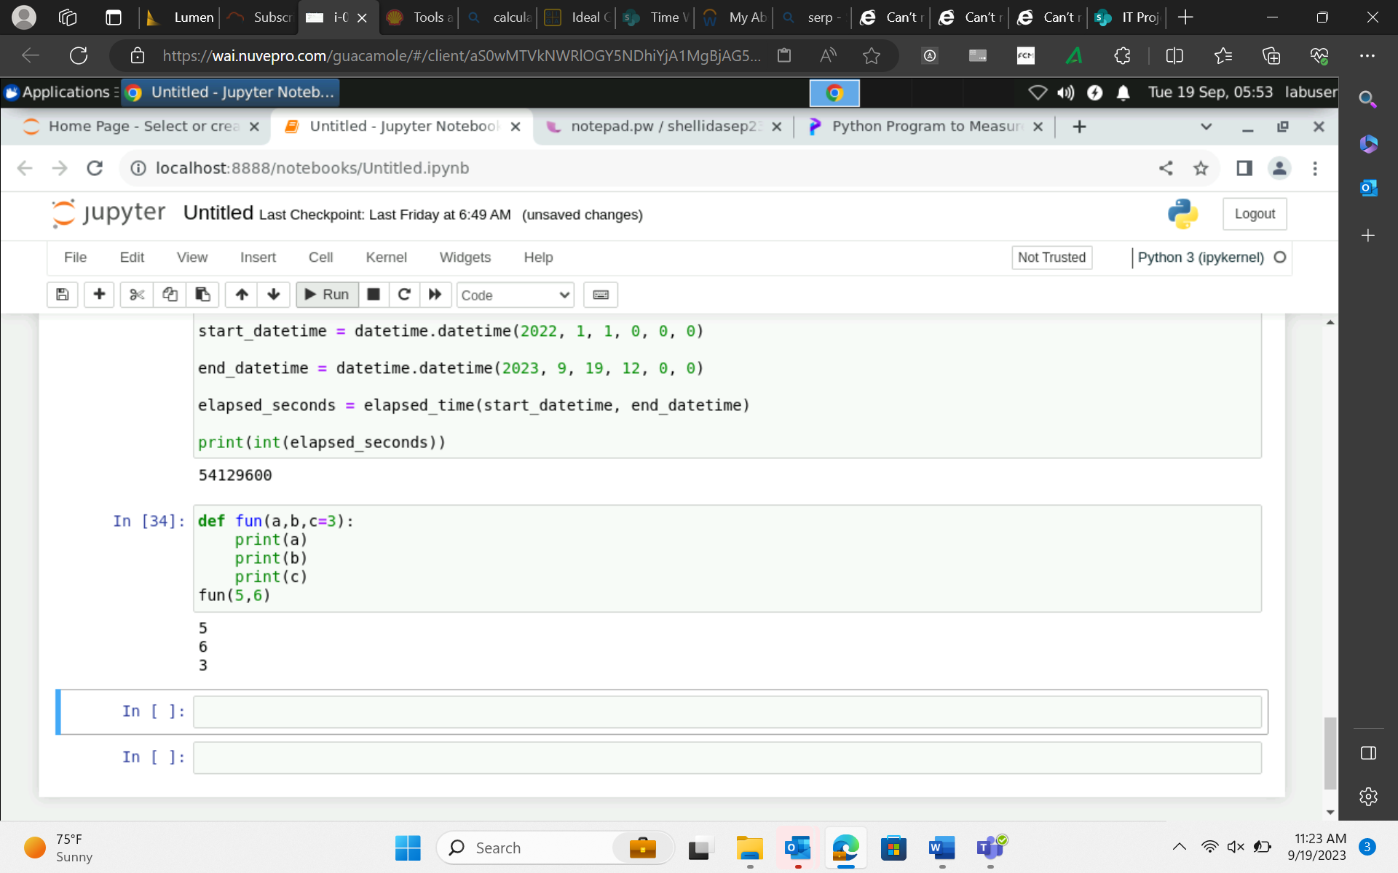
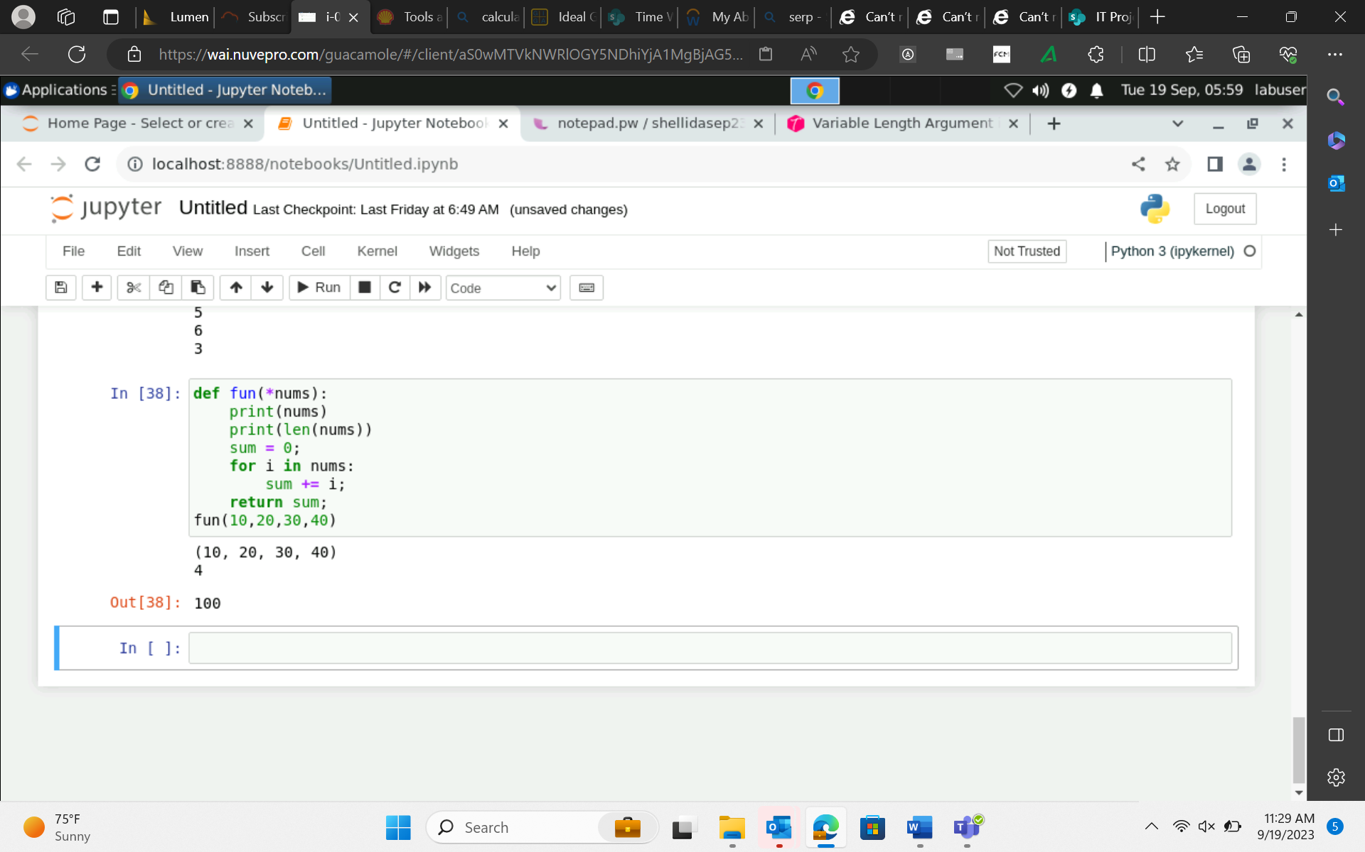
19-Sep-23 (Tuesday) – Python
Arguments :
Positional Arguments -> def fun(a,b,c) → same position → order is very important
Keyword Arguments → def fun(a=1, b=2, c=3)
Default arguments → if value of third parameter not provided then replace with the default value
Variable Length arguments

Slide 5
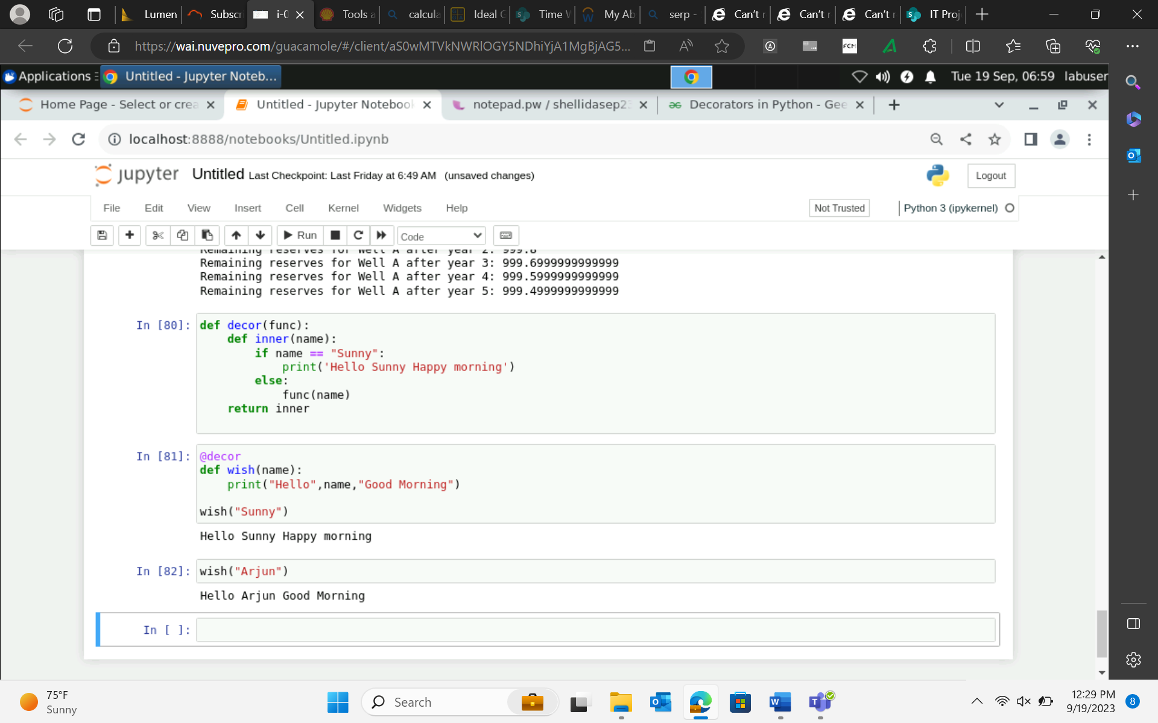
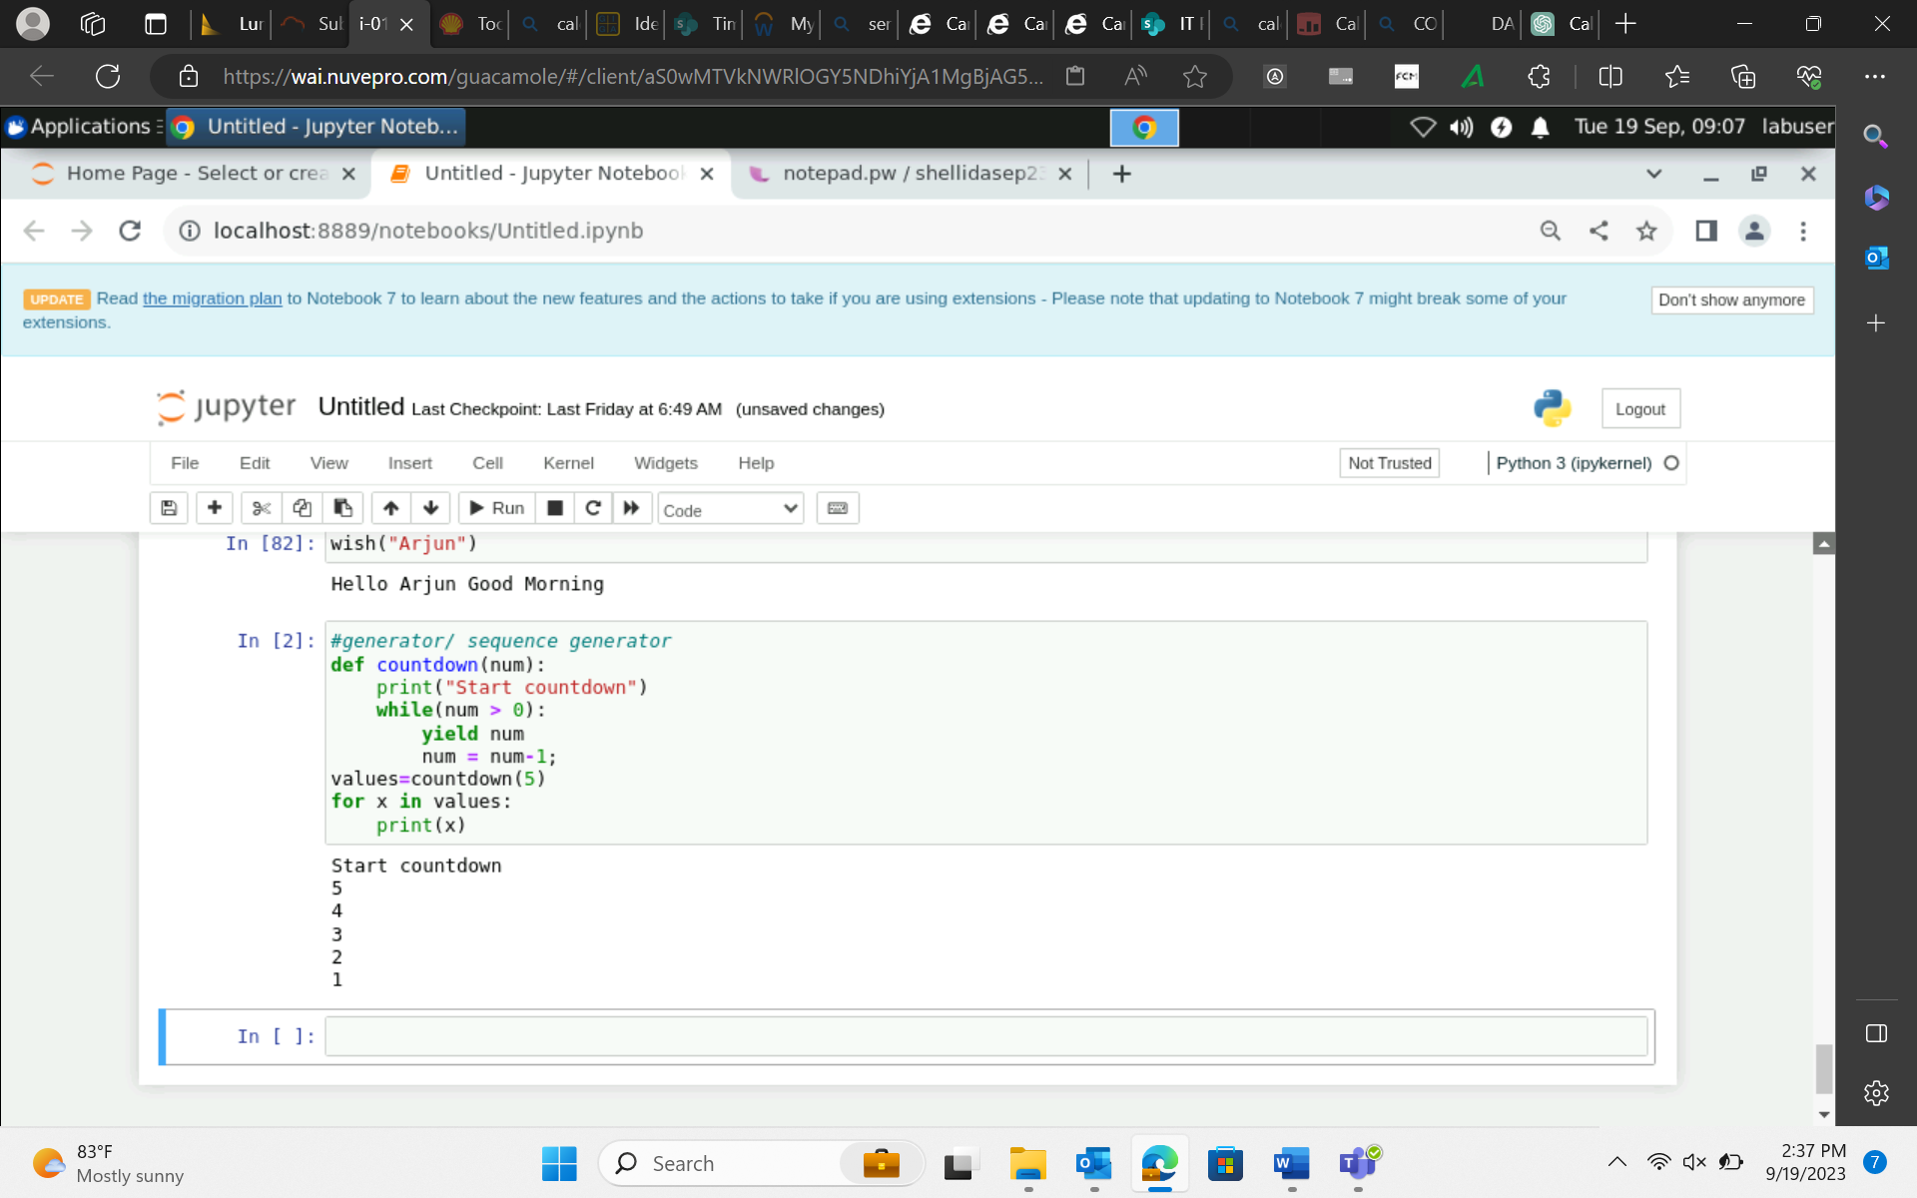
20-Sep-23 (Wednesday) – Python
Decorator function python
Sequence Generator

Slide 6
20-Sep-23 (Wednesday) – Python
Introduction to Panda Dataframe, Series, Lists, Dictionaries, Sets, Tuples, etc.
Parameters:
filepath_or_buffer: Location of the csv file. It accepts any string path or URL of the file.
sep: It stands for separator, default is ‘, ‘.
header: It accepts int, a list of int, row numbers to use as the column names, and the start of the data. If no names are passed, i.e., header=None, then, it will display the first column as 0, the second as 1, and so on.
usecols: Retrieves only selected columns from the CSV file.
nrows: Number of rows to be displayed from the dataset.
index_col: If None, there are no index numbers displayed along with records.
skiprows: Skips passed rows in the new data frame.

Slide 7
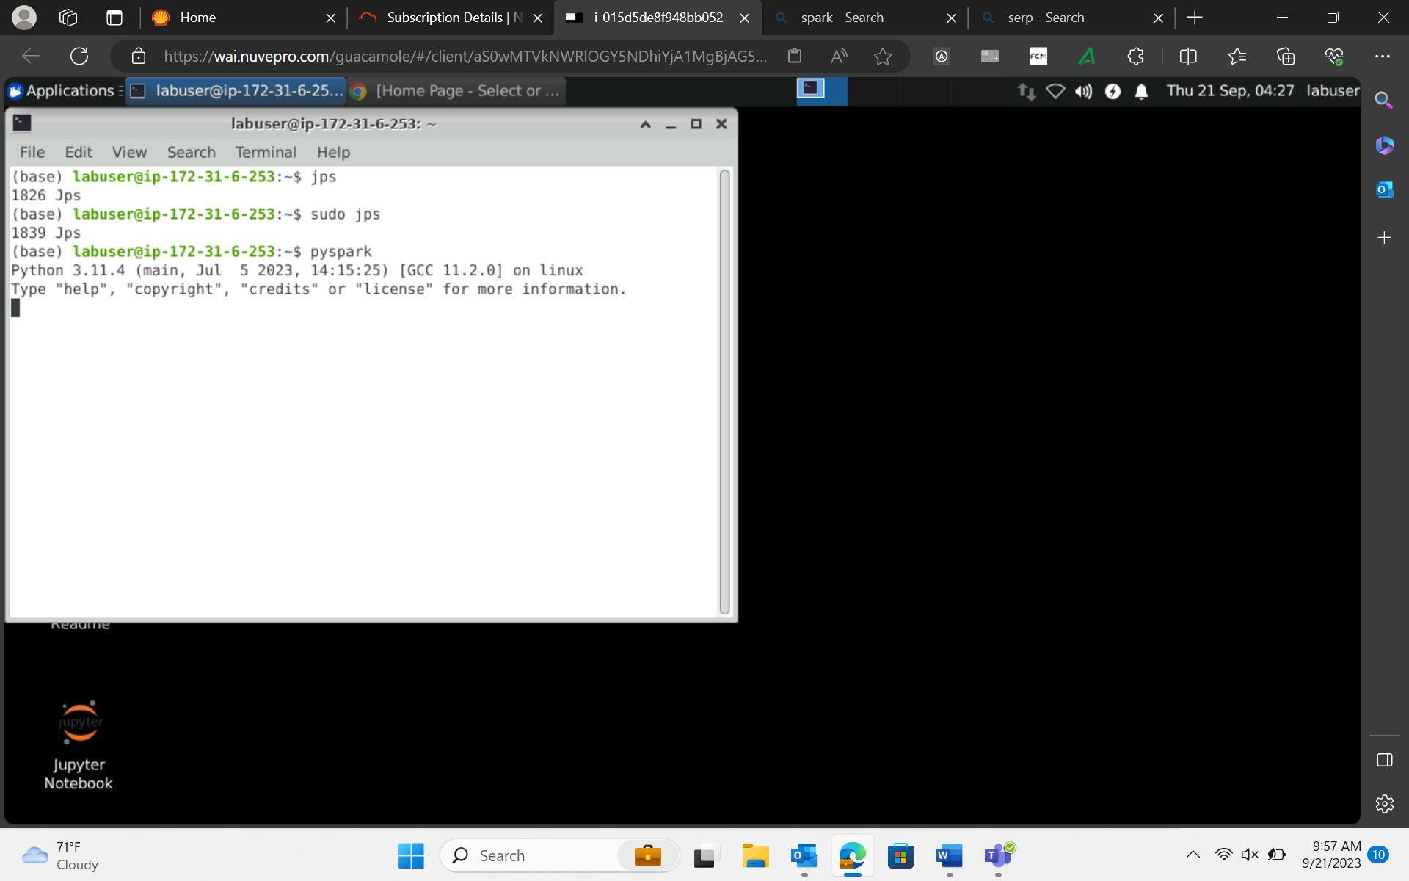
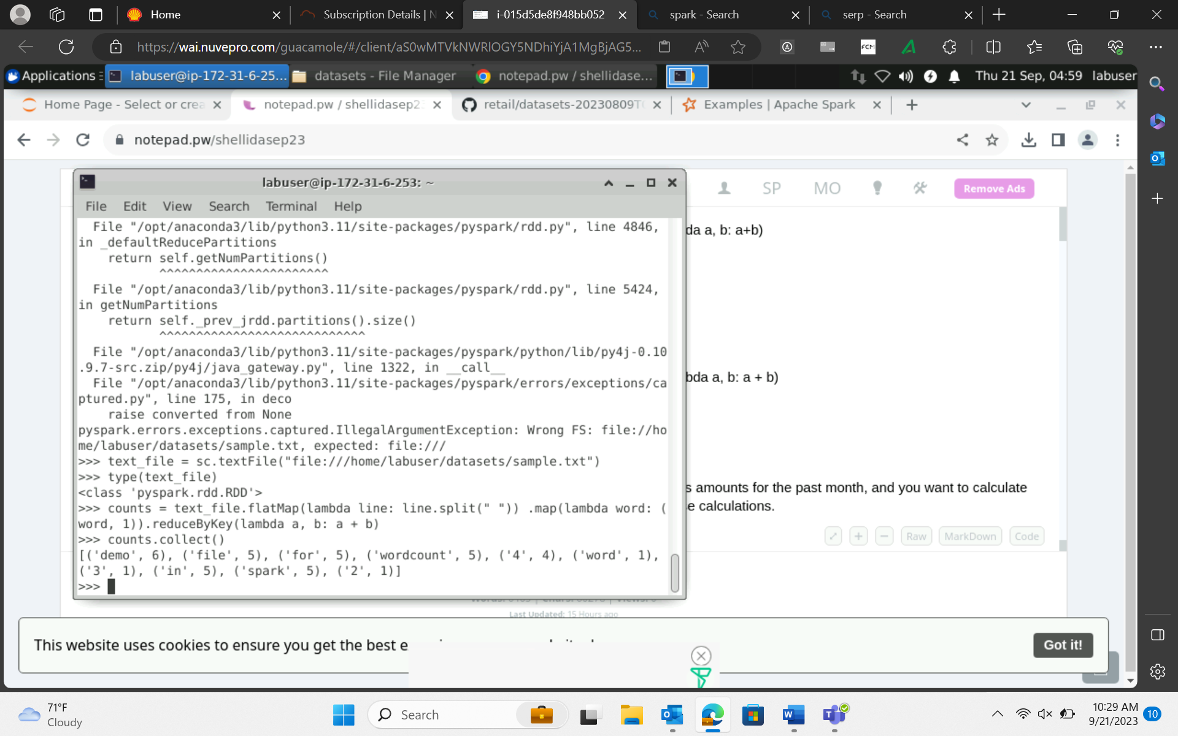
21-Sep-23 (Thursday) – PySpark
PySpark Installation
Wordcount in Pyspark

Slide 8
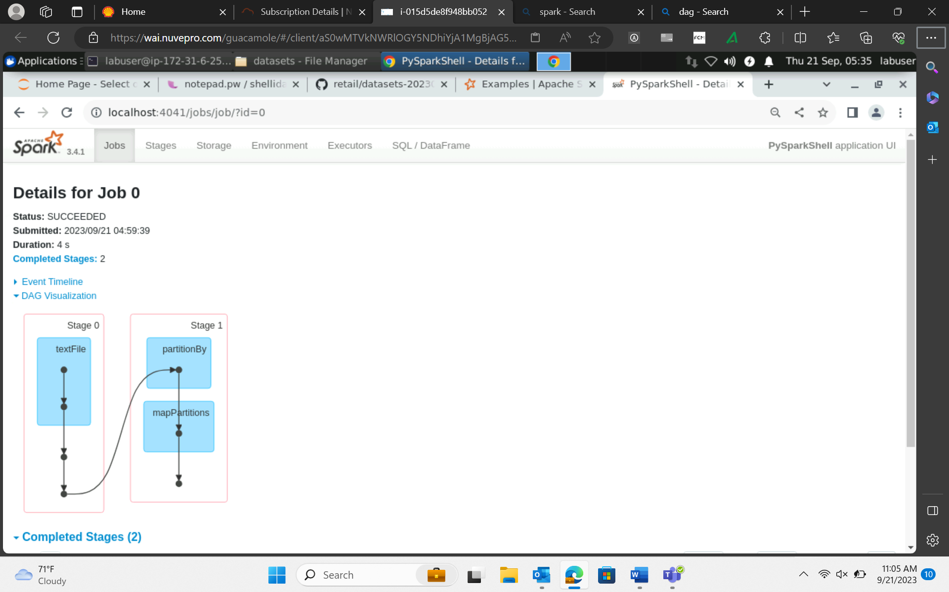
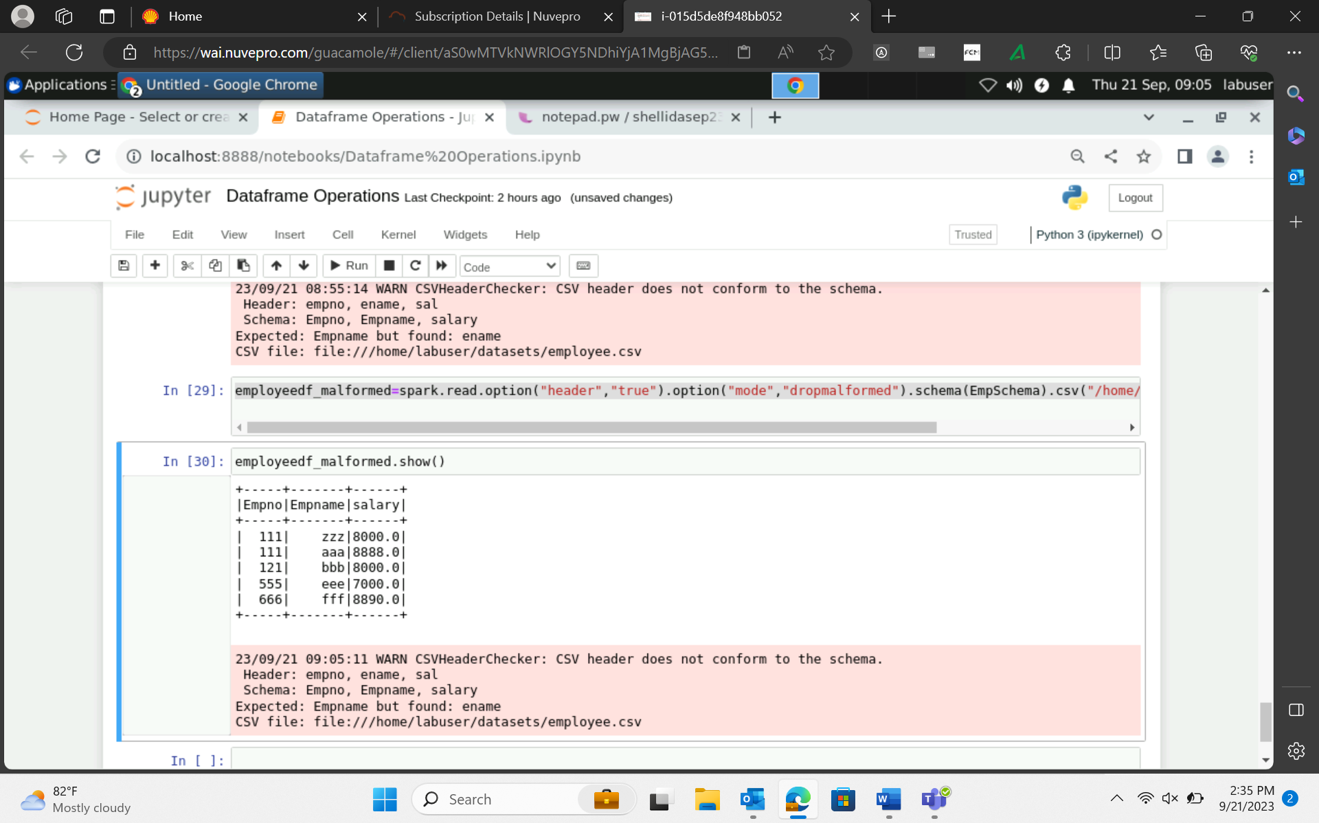
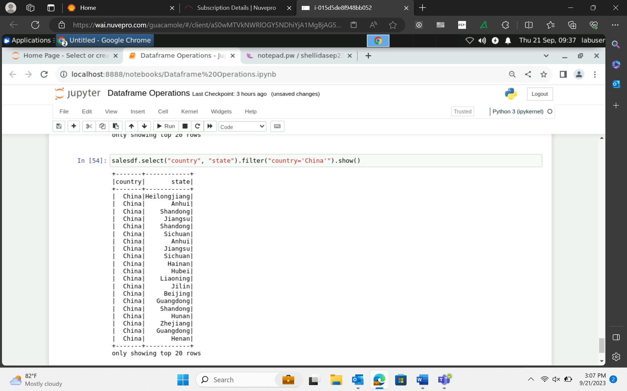
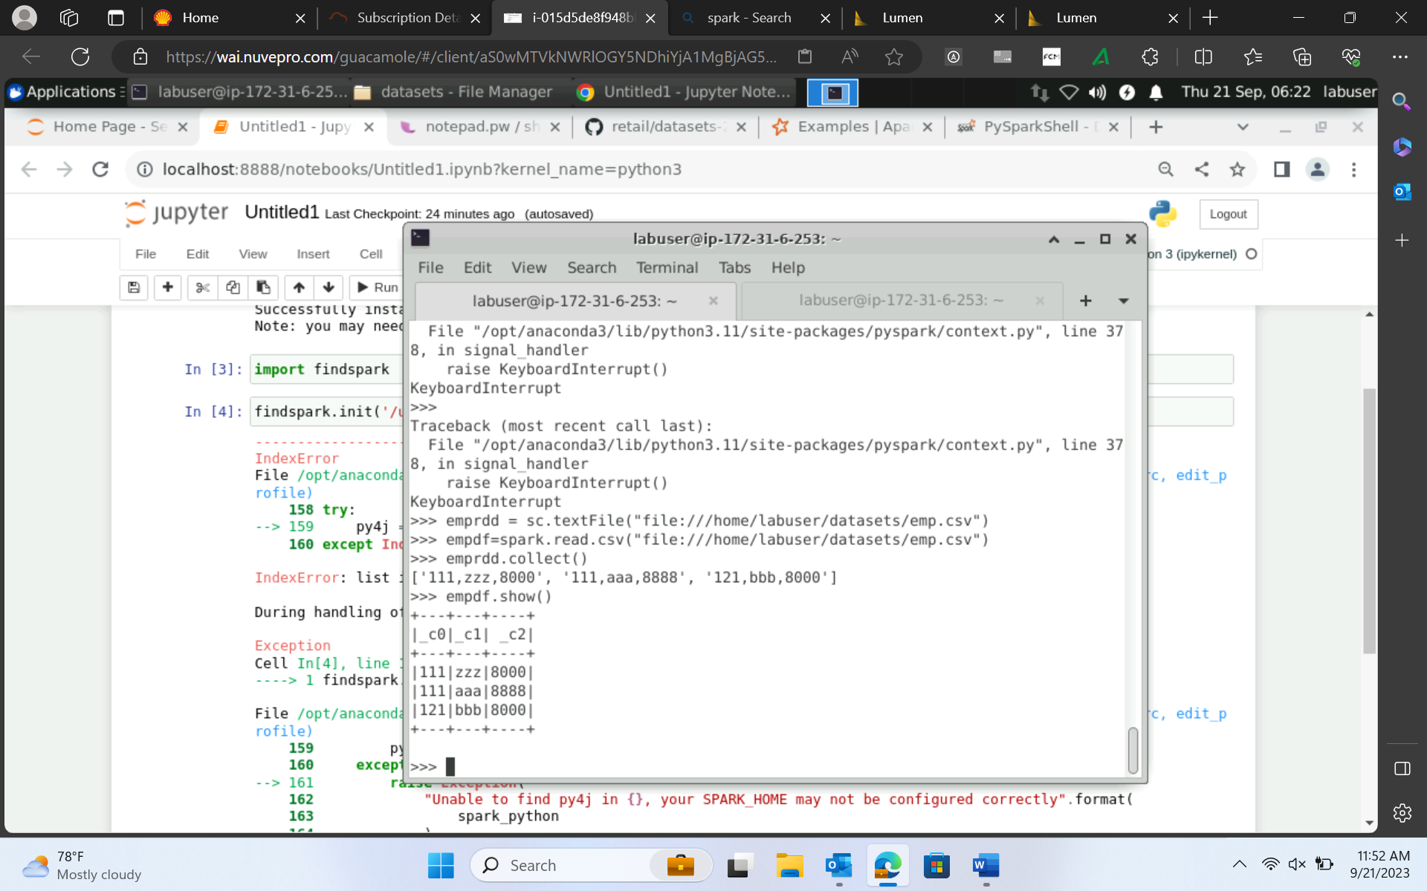
21-Sep-23 (Thursday) – PySpark

Slide 9
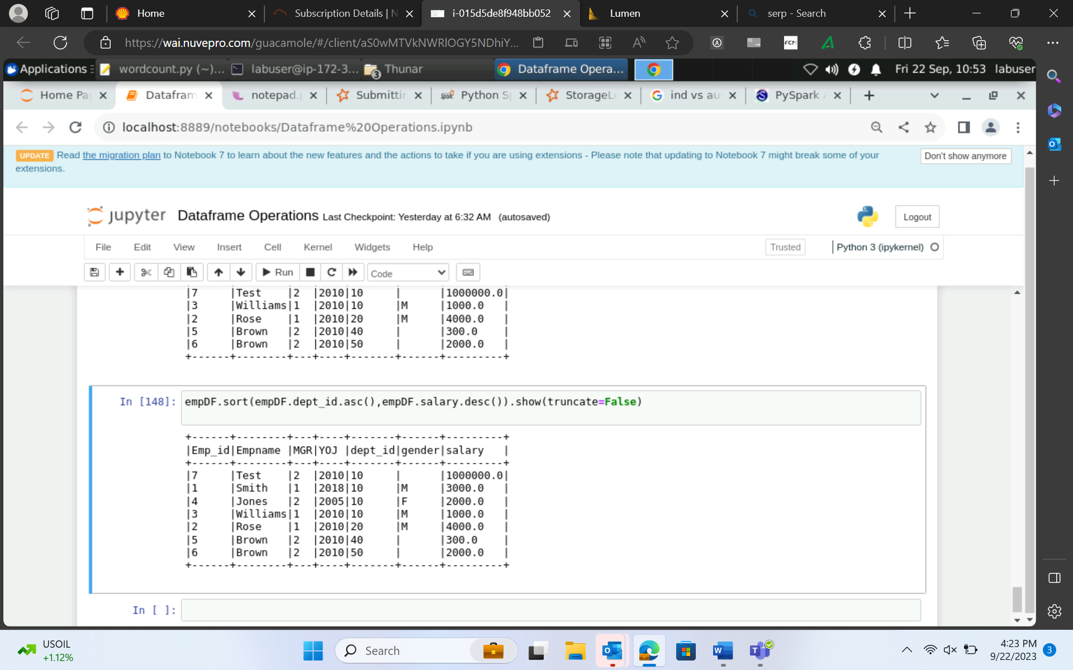
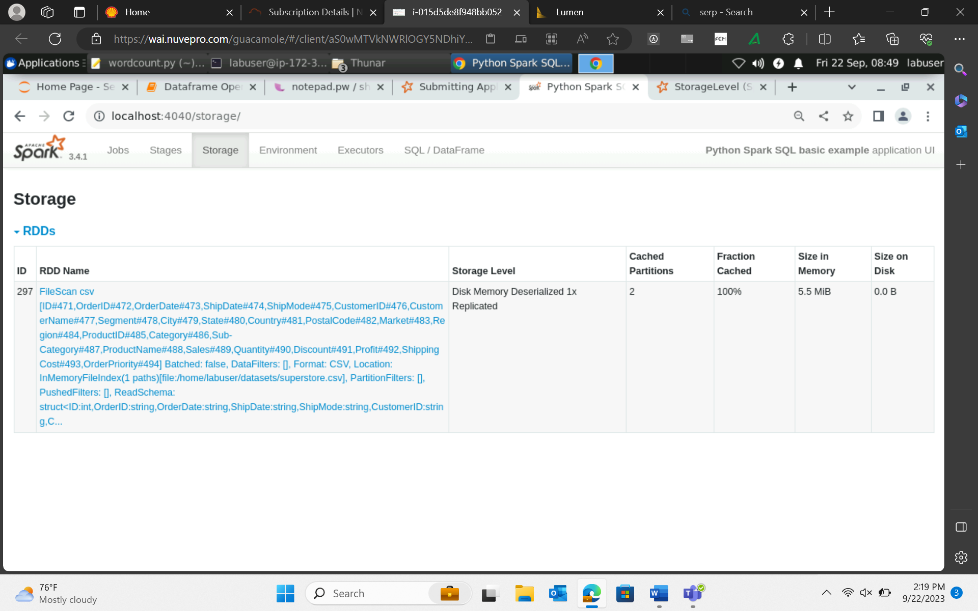
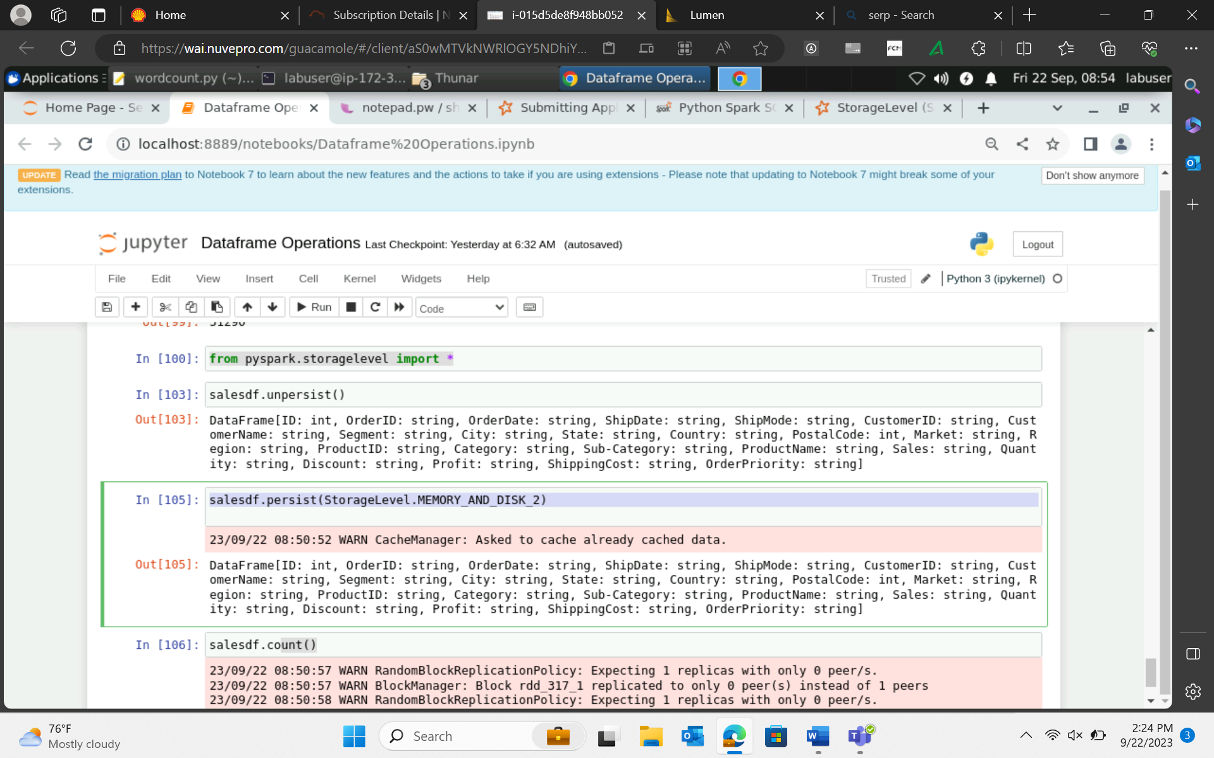
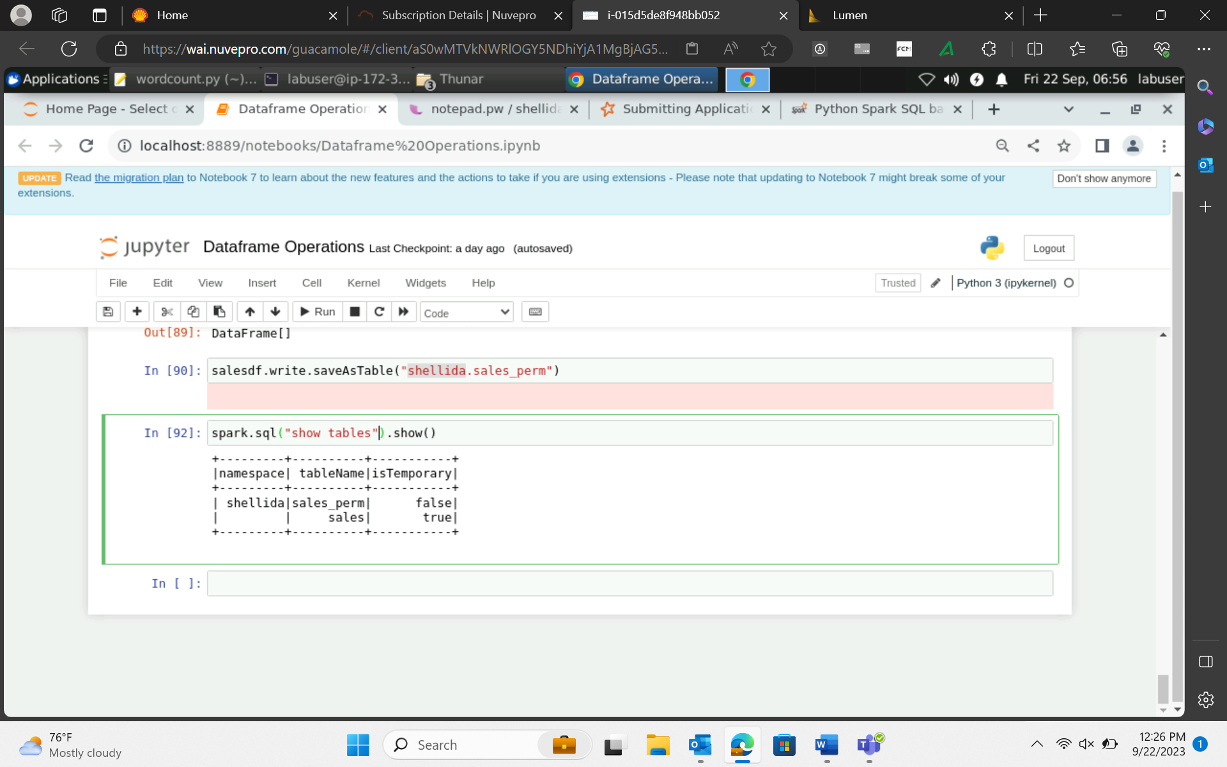
22-Sep-23 (Friday) – PySpark

